Slide 1
Communication and Technology In the Contemporary World
Somdatta Bhattacharya
Department of Hss, IIT Kharagpur

Slide 2
Road MAp
Human Communication
Human Communication Reinvented
Importance, if any
Pitfalls, if any
Pandemic: A Case in Point
Conclusions, if any

Slide 3
The World of Human Communication
As important as the discovery of fire
Crucial for sharing ideas and making decisions
Specific information to specific people at specific time
What we communicate, and how we communicate have radically changed
Human communication has never been more important, nor controversial in the history of human civilization

Slide 4
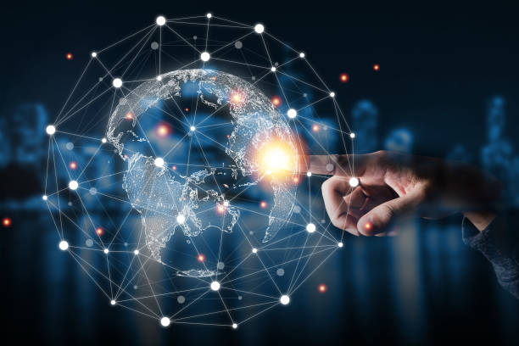

Slide 5
Human communication reinvented
The study of computer-mediated communication (CMC) and new communication technologies (NCTs) is an established and growing field not only with respect to the new technologies becoming available, but also in the many ways we are adopting them for use.
Heightened connection speeds and vast networks of intelligent devices has reinvented communication. Birthday cards, handwritten letters and telephone calls have been overshadowed by ground-breaking technologies such as instant messaging and video calling

Slide 6
Human communication reinvented
A tiny hand-held device carries our address book, telephone, high-definition camera, contactless bank card and access to the internet in our back pockets
Issues such as privacy and anonymity online, cyber-bullying and trolling, online relationships, social networks and social network sites and digital civic engagement have come up in this changed scenario
With it, the language of communication has also changed: Twitter with its 140 characters and LOL/OMG of texting

Slide 7
Why is being connected so important?
In an age where travel to every corner of the globe is easier than ever, many people have a far-reaching, international social network of friends and family. Modern means of communication help us keep in frequent contact
In a society where loneliness is at its peak, instant communication offers those battling with mental health struggles an opportunity to contact someone easily if urgent help is needed.
Social media can reinforce our social lives rather than replace them.

Slide 8
Why is being connected so important?
Productivity of businesses is at an all-time high thanks to improved communication technologies
Workplace hierarchy can be bypassed, as a more casual approach to communication between peers via chat channels such as Slack or WhatsApp softens old-school formalities
Ease of international communication also allows companies to seek overseas employees who can work remotely

Slide 9
Does Modern day Communication have Pitfalls?
Modern means of communication are insecure because the information is centrally in one database. It is likely to be exposed to tampering from corrupt people, and pirates or viruses can also attack it
It affects building relationships, due to the reduction of a direct meeting between people, and the reduction of dependence on actual telephone communication. Misunderstanding, incomplete information, limited feedback are all fallouts
Social fabric is loosened and people can remain untraced and incognito. Trust building becomes difficult

Slide 10
Does Modern day Communication have Pitfalls?
Modern means of communication are harmful to health, especially as they use low-frequency signaling technology, which may cause fatigue and sleep problems
Technology keeps us together but there is A LOT of room for error in the written word. When you receive an email or text message you typically read it in your own voice with your own tone, and that’s not always the tone that the author intended it. Interpretation could really become misinterpretation

Slide 11
Pandemic: A Case in Point
Normal social conventions have been put on hold or have been altered
The disruption has provided both challenges and opportunities
Protective measures (social distancing/masking) have posed problems for interpersonal communication, creating discordance between verbal and non-verbal communication
Tricia Jones talks about strategies we are using, “such as elbow bumps rather than fist bumps”, which are entertaining, but they also send the message that this is artificial, and we aren't being “authentic the way we used to be”, because we are putting on a “performance”

Slide 12
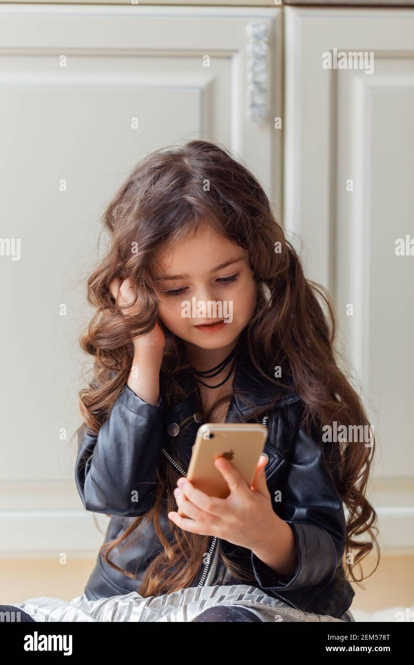

Slide 13
Pandemic: A Case in Point
We are learning how to use language to stand in for the courtesy we would otherwise show nonverbally—and building a new set of norms along the way
For young people, these habits could become permanent. The pandemic is accelerating young people’s shift away from nonverbal communication, because of their excessive dependence on their devices
Device based communication means not learning or forgetting non-verbal cues

Slide 14
In conclusion…
Even without pandemics, what is “normal” changes over time
Social media and digital communication are sure to remain important for the foreseeable future.
Changes in communication technology are going to be radical and fast paced
But they will not replace face-to-face interaction

